Slide 1

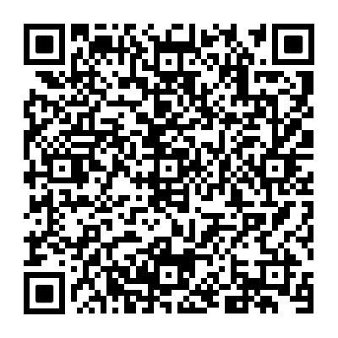


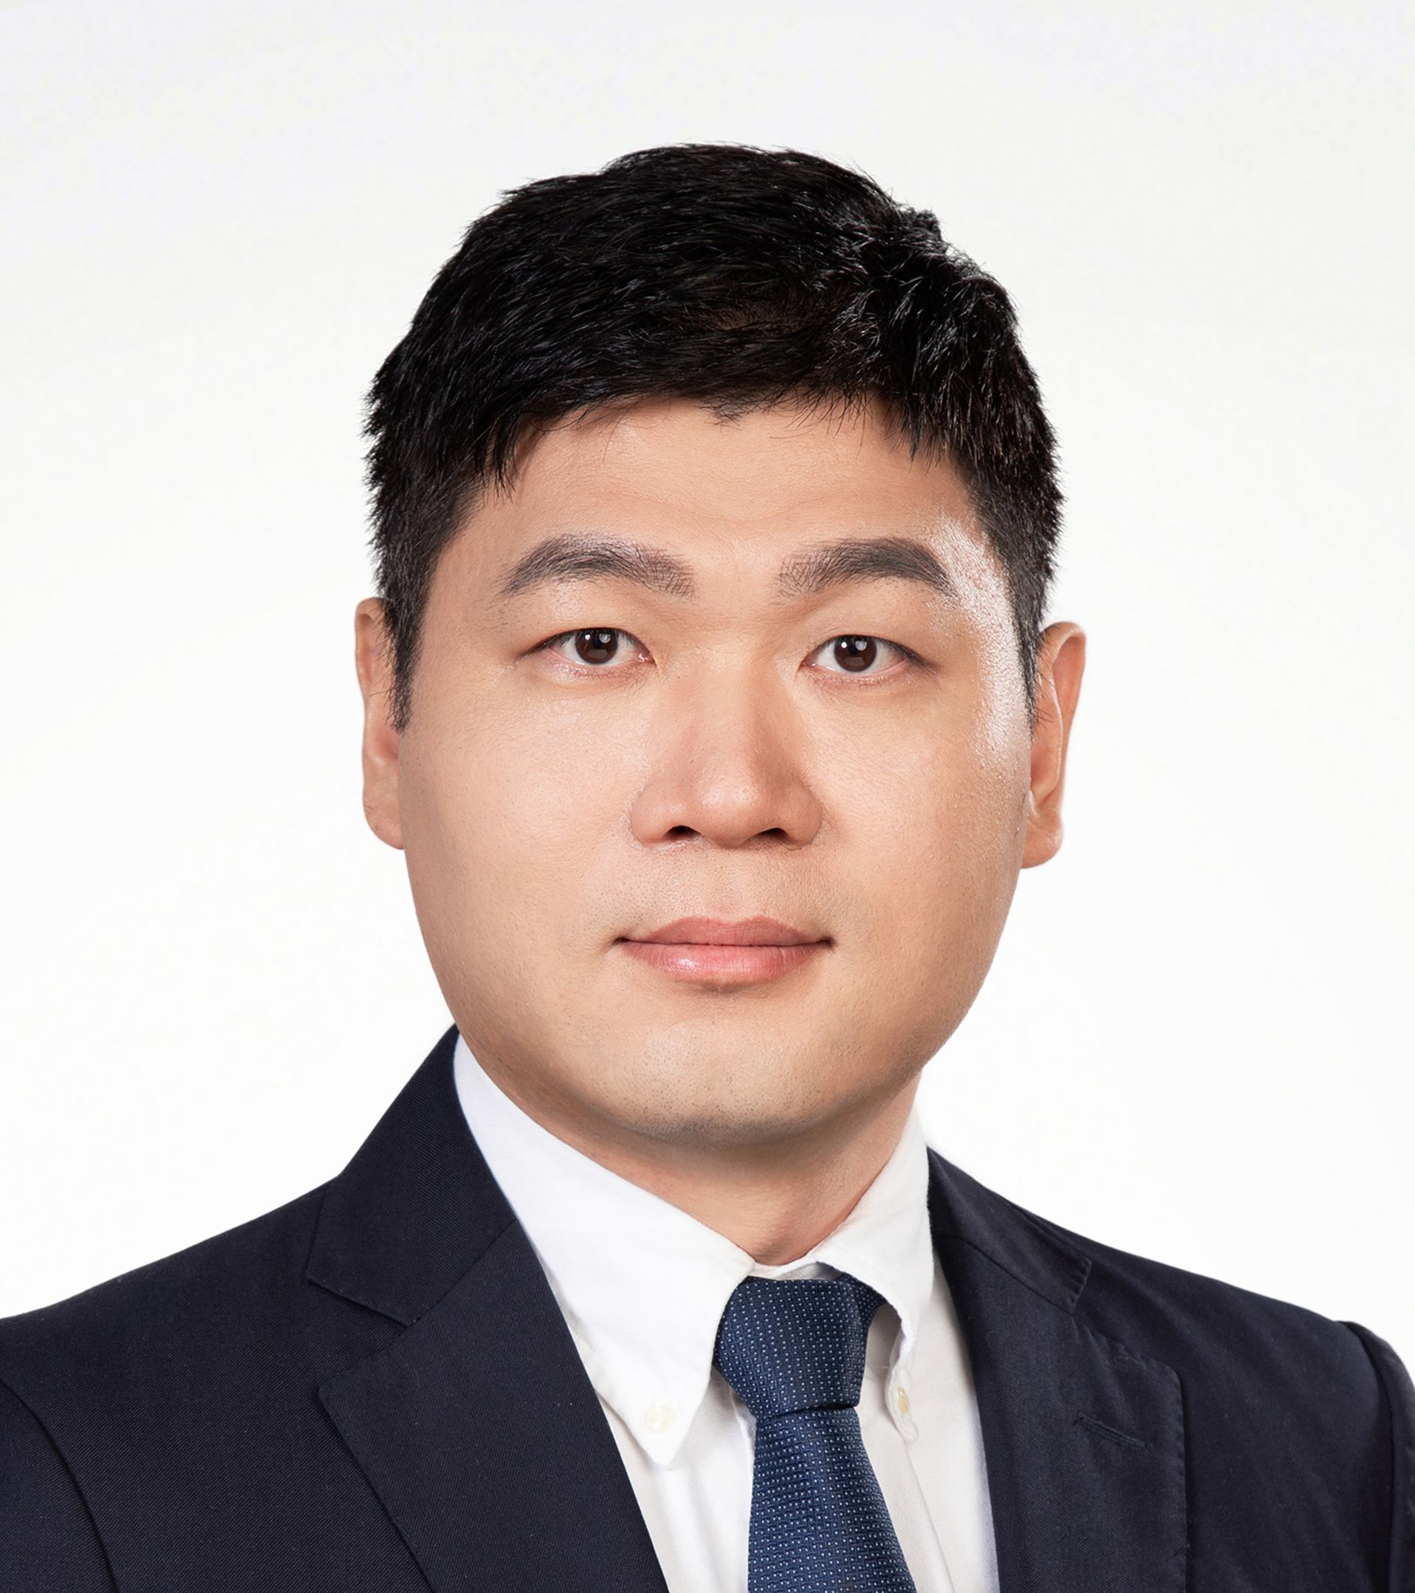
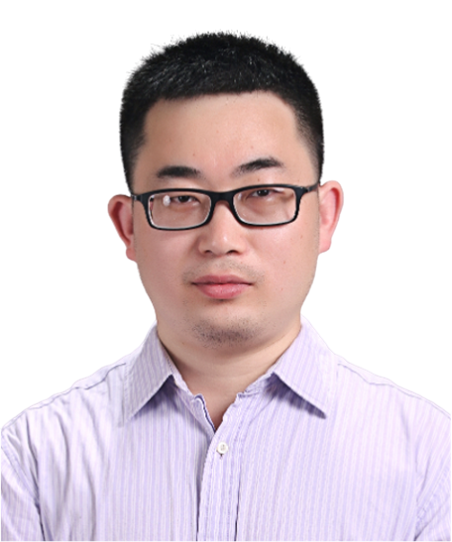
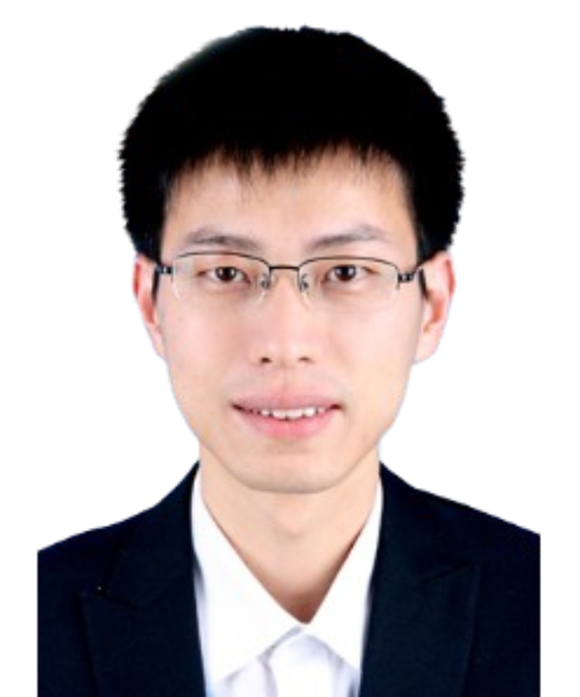
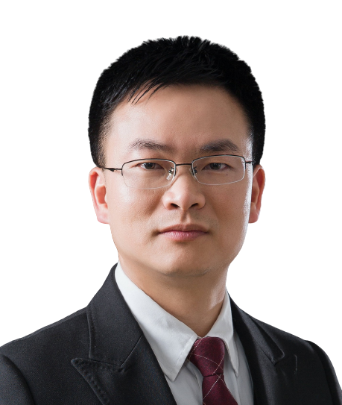
Revisiting the dogma on bacterial transcriptome organization: implications on gene expression
Time (IST): 2025-03-27 10:00
Time (China): 2025-03-27 16:00
Zoom ID: 893 0005 4861
Passcode: 123456
Zoom meeting link: https://us06web.zoom.us/j/89300054861?pwd=TZbjJuSwrz4lTdg8yKCwDKKDDzqwNe.1
Bilibili：https://live.bilibili.com/26427894
Orna Amster-Choder
Full Professor, Faculty of Medicine, Department of Microbiology and Molecular Genetics – The Hebrew University, Jerusalem, Israel
Abstract:
Our finding that bacterial RNAs can localize to different cellular domains independently of translation (Science, 2011) challenged the dogma that transcription and translation are always coupled. Analysis of the E. coli transcriptome revealed that a significant fraction localizes asymmetrically, often correlating with proteome distribution and independent of translation (Mol. Cell, 2019). Notably, the polar transcriptome is unique, enriched in specific mRNAs and most small RNAs (sRNAs).
sRNA: We demonstrated a polygenic plan for sRNA-mediated regulation, explaining the subtle effects of specific sRNA deletions (iScience, 2021). We also found that sRNAs are accompanied by their chaperone Hfq, which undergoes phase separation at the poles, a process essential for its activity (Cell Rep, 2022). Multiomic analyses suggest compartmentalization of certain metabolic pathways, including ATP production, in these regions.
mRNA: We recently showed that the pole-to-pole oscillating MinD protein and RNase E control mRNA enrichment at the poles by preventing site-specific degradation. Mislocalization of polar mRNAs may disrupt protein localization, indicating localized translation in bacteria (EMBO J, 2024).
Coupled transcription-translation (CTT): We developed a method to map the transcriptome-wide CTT landscape in three model organisms at near-single codon resolution. Our results indicate that significant gene expression occurs without CTT and identify factors influencing CTT dynamics.
HOST＆PANELISTS
Host: Zhichao Miao
Guangzhou Laboratory
Guangzhou Medical University
Jinkai Wang
Sun Yat-sen University
Zongfu Wu
Nanjing Agricultural University
Lin Huang
Sun Yat-sen University
Sponsors

Slide 2
重新审视细菌转录组组织的传统观点：对基因表达的启示
北京时间: 2025-03-27 16:00
Zoom 会议号: 893 0005 4861
密码: 123456
Zoom 会议链接: https://us06web.zoom.us/j/89300054861?pwd=TZbjJuSwrz4lTdg8yKCwDKKDDzqwNe.1
腾讯会议号： 723-640-992
B站：https://live.bilibili.com/26427894
Orna Amster-Choder
医学院微生物学和分子遗传学系教授， 以色列耶路撒冷希伯来大学，以色列
摘要：
我们的研究发现，细菌RNA可以在不同的细胞区域内定位，而不依赖于翻译（Science, 2011），这一发现挑战了转录与翻译始终偶联的传统观点。对大肠杆菌（E. coli）转录组的分析表明，相当一部分RNA呈现不对称定位，这种现象通常与蛋白质组分布相关，并且独立于翻译（Mol. Cell, 2019）。值得注意的是，极性转录组具有独特性，其中富含特定的mRNA和大多数小RNA（sRNA）。
sRNA： 我们证明了sRNA介导调控的多基因机制，解释了特定sRNA缺失所带来的微妙效应（iScience, 2021）。此外，我们发现sRNA与其伴侣蛋白Hfq共存，而Hfq在细胞极端发生相分离，这一过程对其活性至关重要（Cell Rep, 2022）。多组学分析表明，包括ATP合成在内的某些代谢通路可能在这些区域内形成区隔化。
mRNA： 我们最近发现，从极点到极点振荡的MinD蛋白和RNase E通过防止特定位点的降解来调控mRNA在极点的富集。极性mRNA的错误定位可能会破坏蛋白质的正确定位，这表明细菌中可能存在局部翻译（EMBO J, 2024）。
偶联转录-翻译（CTT）： 我们开发了一种方法，以近单密码子分辨率绘制三个模式生物的转录组范围内的CTT图谱。我们的研究结果表明，大量基因表达可以在没有CTT的情况下发生，并确定了影响CTT动态的关键因素。
主持人＆嘉宾
主持人：苗智超
广州实验室
广州医科大学
王金凯
中山大学
吴宗福
南京农业大学
黄林
中山大学
赞助商

